Slide 1
Cyber-Physical Security Through Information Flow
Bruce McMillin
Professor, Department of Computer Science
2018-2020 Distinguished Visitor
Missouri University of Science and Technology
325 Computer Science, 500 W. 15th St., Rolla, MO 65409
o/ (573) 341-6435 e/ ff@mst.edu

Slide 2
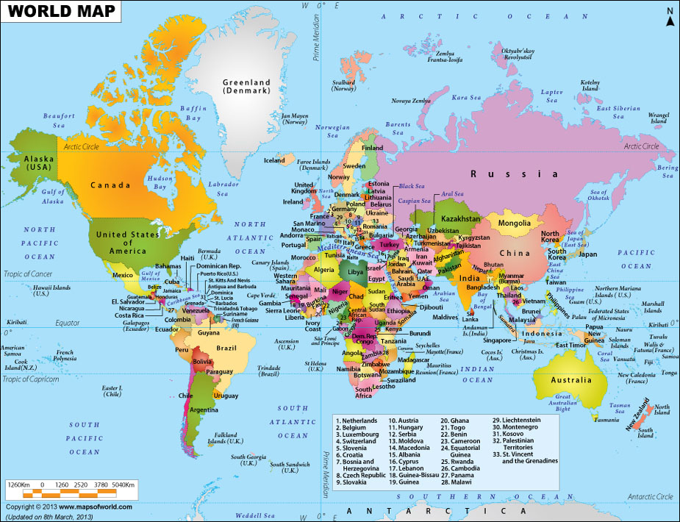
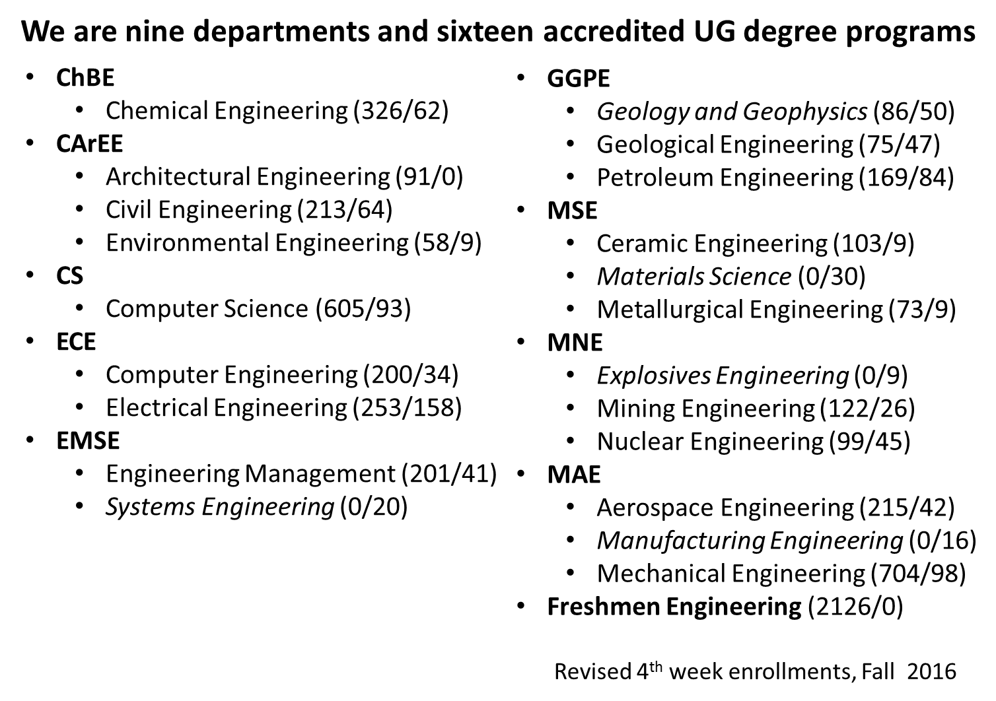
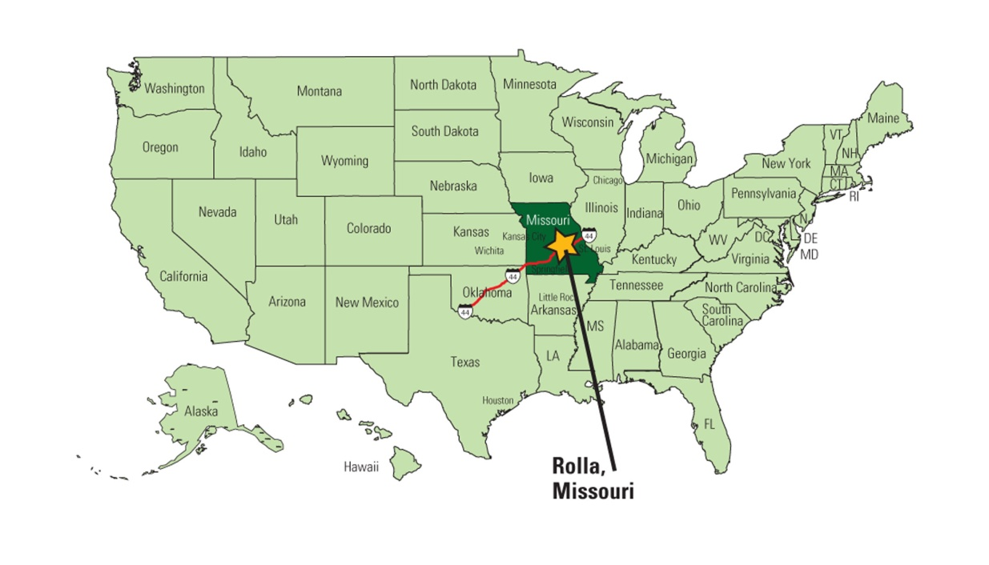
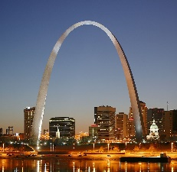
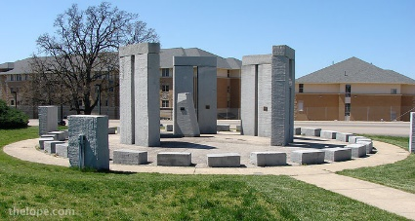
Where is Missouri S&T
9 9 Departments, 7500 Students in Engineering

Slide 3
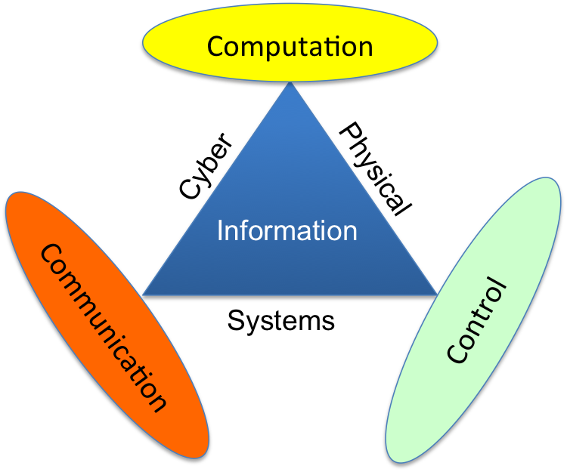
CPS
Cyber-Physical Systems (CPS) are physical systems that are controlled and monitored through computer-based systems.
Critical infrastructures of a nation are CPS
Water treatment plant
Smart grid
Manufacturing plant
Autonomous Vehicle
Airspace Management
Notes:
P

Slide 4
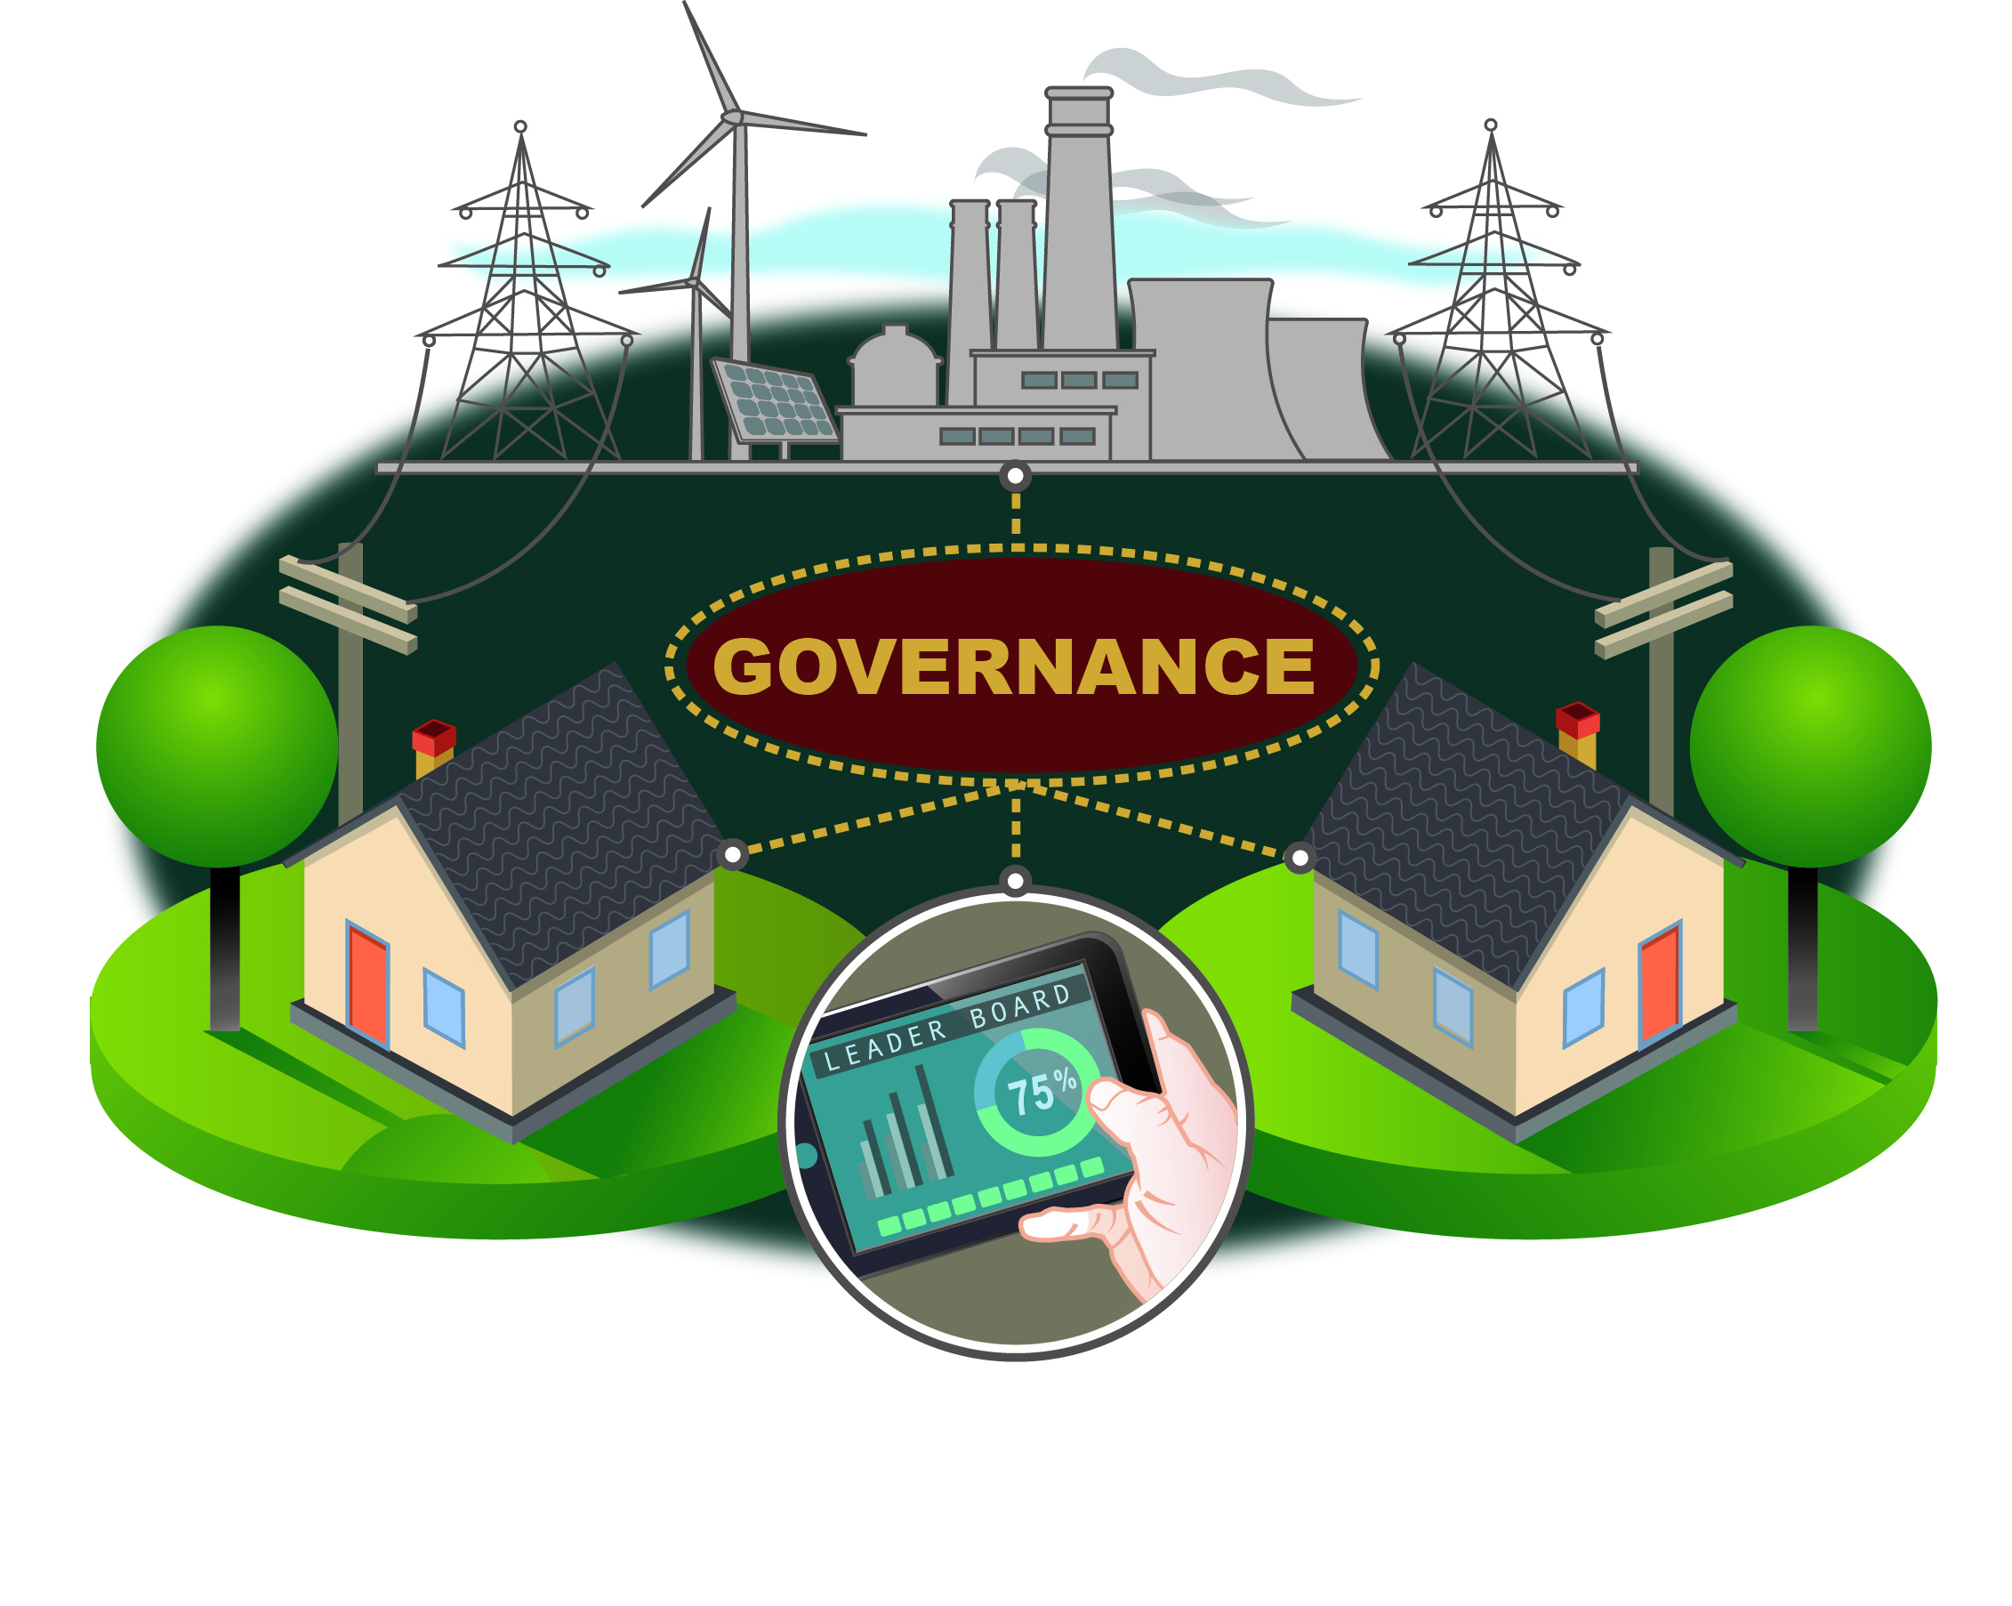
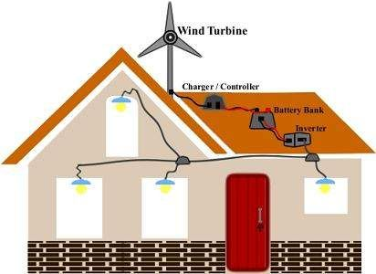
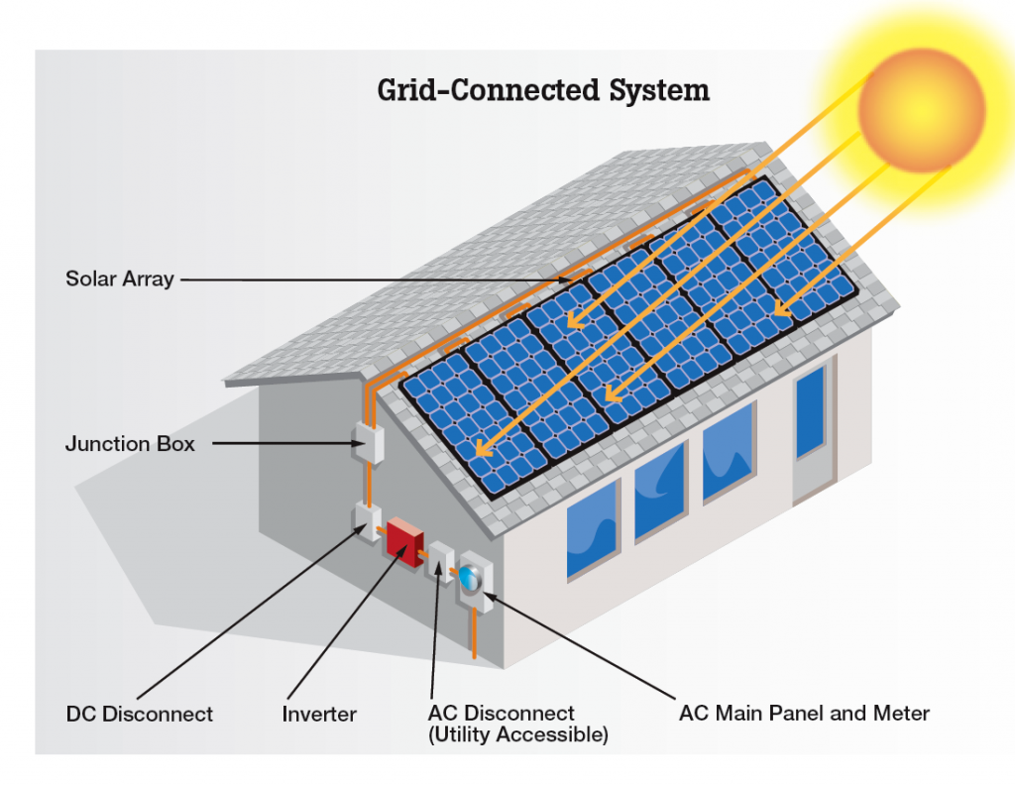
A modern Cyber-Physical System
Community
Local Management
Locally Sourced

Slide 5
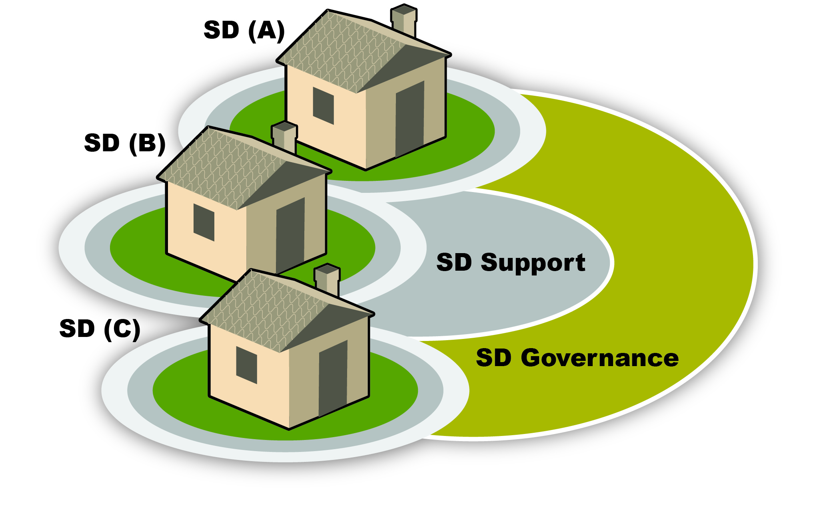
Modern Security Domains
Community
Local Management
Locally Sourced
Secure
Privacy Preserving

Slide 6
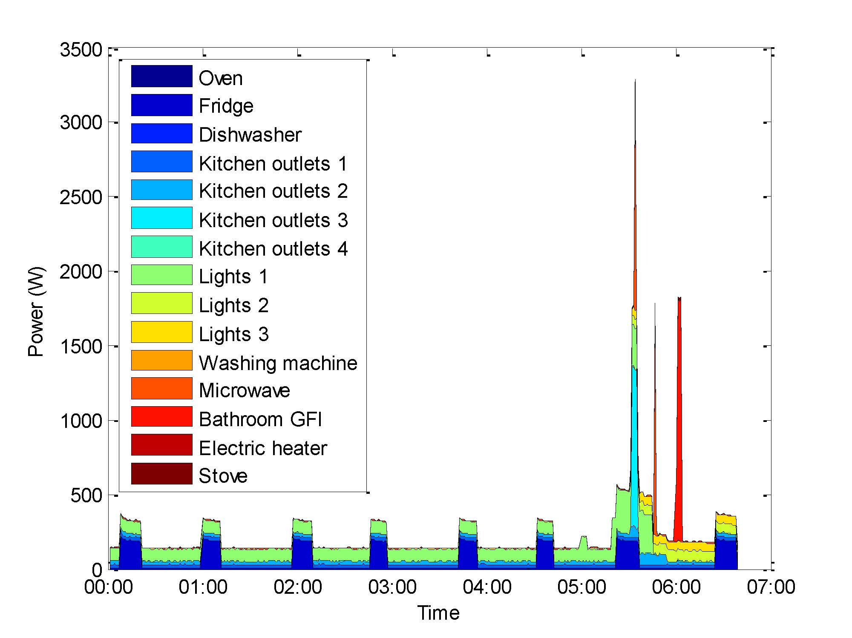
Non-Intrusive Load Monitoring

Slide 7
Management and Governance
Utility?
NISTIR 7628
Cloud?
NERC CIP
Timing
Fog?
IoT
Locally Managed
Locally Protected

Slide 8
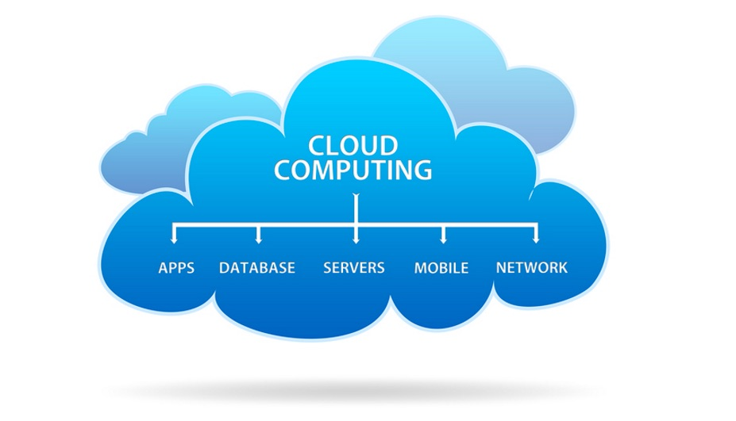
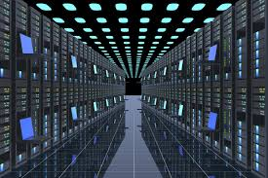


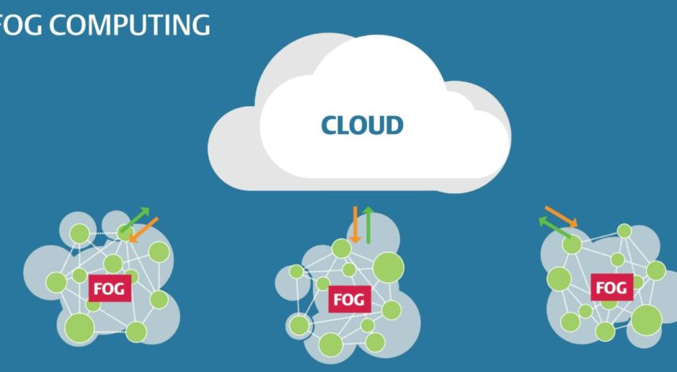
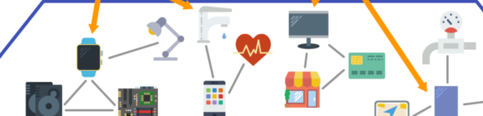
Cloud
Dew
Fog
Mist
https://www.pubnub.com/blog/moving-the-cloud-to-the-edge-computing/
https://www.wired.com/story/its-time-to-think-beyond-cloud-computing/
http://thewallpaper.co/dew-drops-high-definition-wallpaper-download-dew-drops-images-free-wallpaper-of-windows-desktop-images-high-resolution-1920x1080/
https://www.etsy.com/listing/559016362/there-is-no-cloud-its-just-someone-else
https://electronicsofthings.com/expert-opinion/fog-computing-relevance-iot/

Slide 9
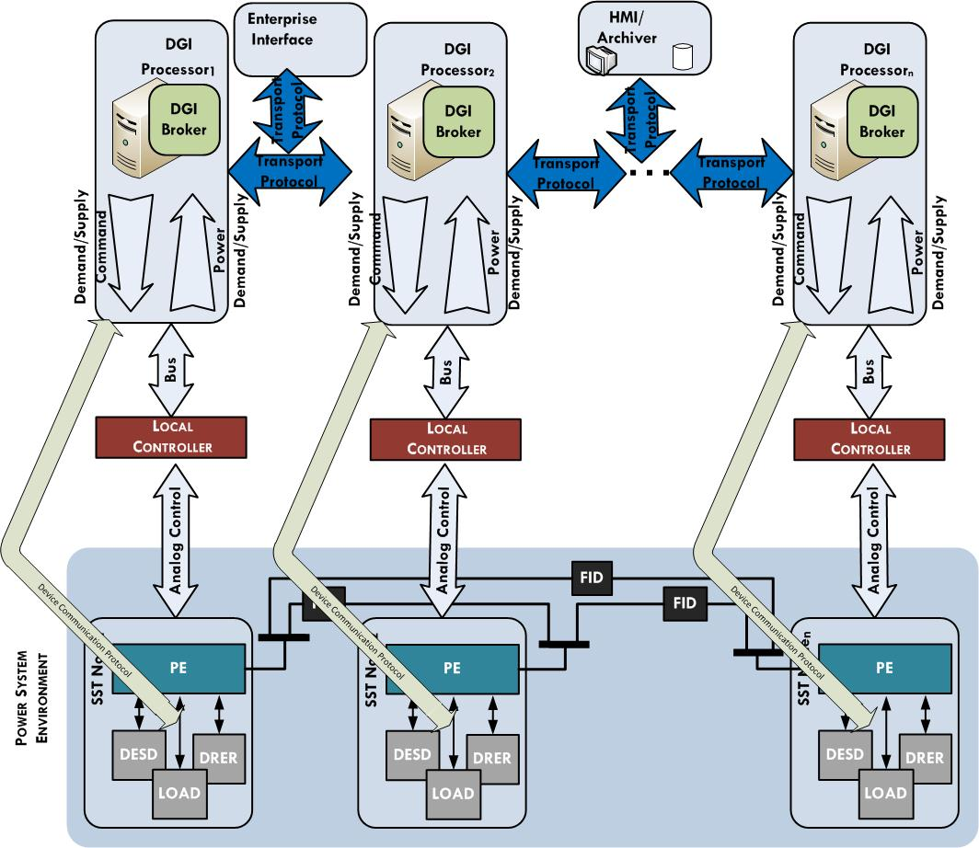
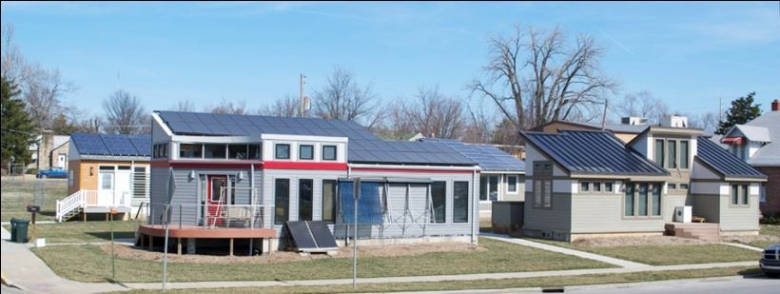
Transactive Energy Management
More Critical need
Lesser need
Who needs Power?
Transfer Power

Slide 10
c
c
Peer-to-peer transactive energy
c
c
c
c
c

Slide 11
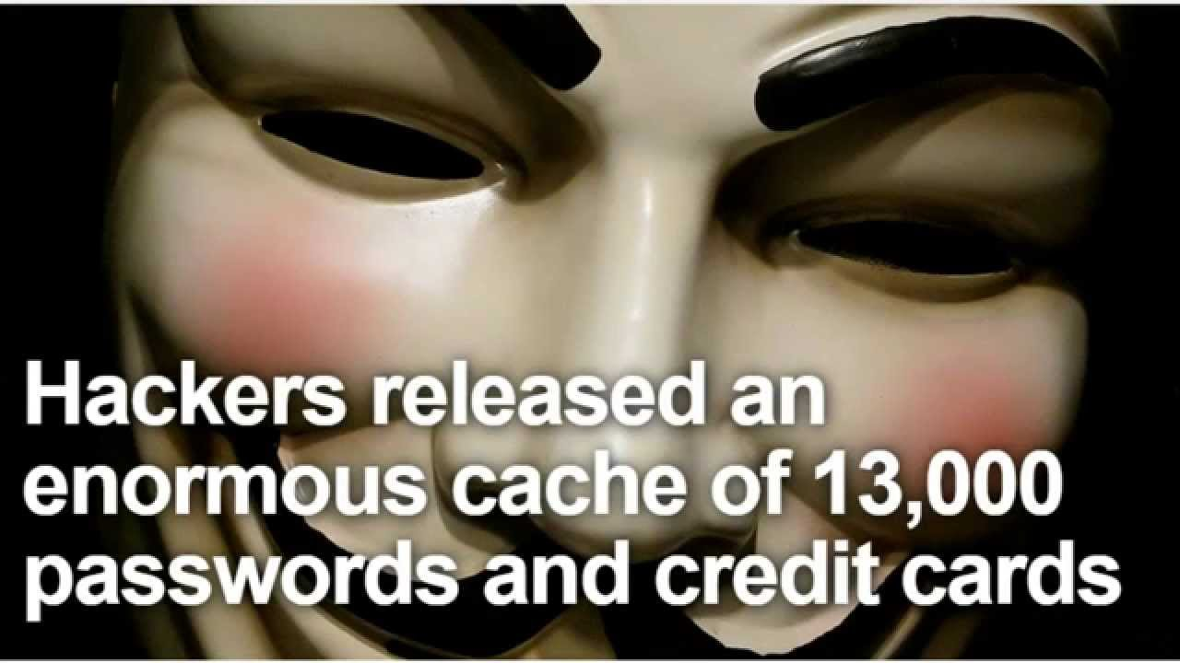
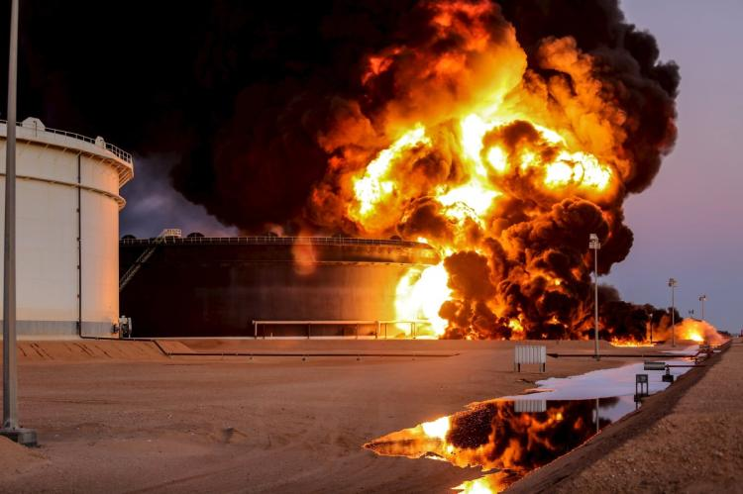


Threats
Physical
Cyber
Cyber-enabled Physical
Physically-enabled Cyber
Stealing Plant Secrets

Slide 12
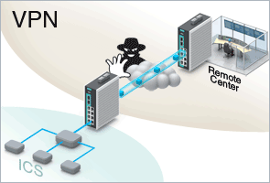
Firewalls
Figure Source, Manufacturers Automation, Inc.

Slide 13

Seems Simple, What could go wrong?
Physical
Cyber
Cyber-enabled Physical
Physically-enabled Cyber

Slide 14
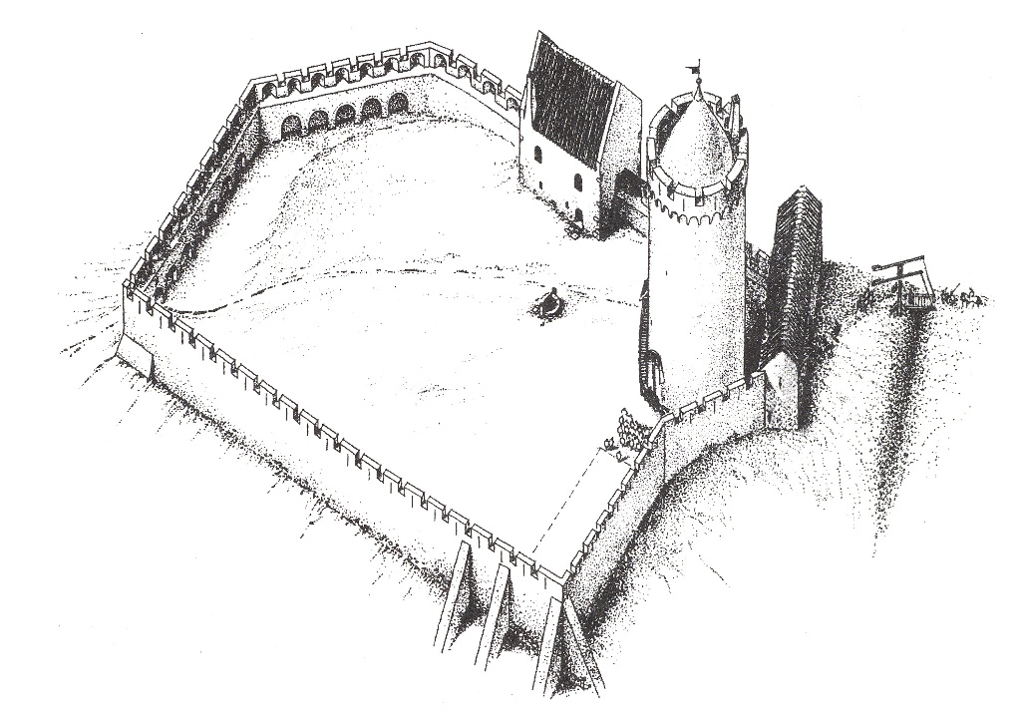

Slide 20

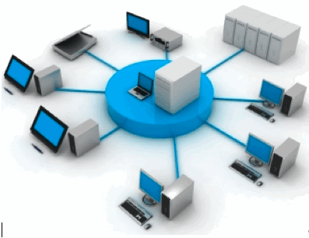




SCADA System - from National Academies
System Control Center
Data to market and other systems
EMS
Energy Management System
SCADA
Supervisory Control and Data Acquisition
RTU
Remote Terminal unit
RTU
Remote Terminal unit
RTU
Remote Terminal unit
Sensor Actuators, etc.,
Sensor Actuators, etc.,
Sensor Actuators, etc.,
A
Business Network
Centralized Supervisory Control And Data Acquisition (SCADA)
Electric Utility Control
Messages

Slide 21
Solarwinds
"SolarWinds is one of the most widely used and effective tools for network monitoring
piggybacking on otherwise trusted software updates,
That's what's so scary: It's not clear what could have been done differently in this case, because the very process meant to reassure users that "this software can be trusted" was itself compromised.

Slide 22
Biba Model - 1975
Integrity Levels:
The higher the level, the more confidence
That a program will execute correctly
That data is accurate and/or reliable
Note relationship between integrity and trustworthiness
Important point: integrity levels are not security levels

Slide 23
Problems
Subjects’ integrity levels decrease as system runs
Soon no subject will be able to access objects at high integrity levels
Alternative: change object levels rather than subject levels
Soon all objects will be at the lowest integrity level
Crux of problem is model prevents indirect modification
Because subject levels lowered when subject reads from low-integrity object

Slide 24




Slide 25
BIBA
A
System Control Center
Data to market and other systems
EMS
Energy Management System
SCADA
Supervisory Control and Data Acquisition
RTU
Remote Terminal unit
RTU
Remote Terminal unit
RTU
Remote Terminal unit
Sensor Actuators, etc.,
Sensor Actuators, etc.,
Sensor Actuators, etc.,
B
Business Network
Messages

Slide 26
Security? Bell-La Padula
Military Multi-Level Security Model
No Read Up
No Write Down
Top Secret
No Read Up
Secret
Military Commander
Write to troops?
Confidential
Downgrade
No Write Down
Trust
Unclassified

Slide 27

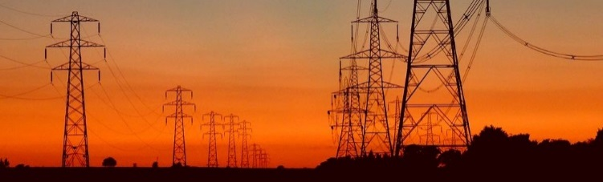
1
Data to market and other systems
BLP
Business Network
2
System Control Center
EMS
Energy Management System
Data to market and other systems
SCADA
Supervisory Control and Data Acquisition
3
RTU
Remote Terminal unit
RTU
Remote Terminal unit
RTU
Remote Terminal unit
Data to market and other systems
4
Sensor Actuators, etc.,
Sensor Actuators, etc.,
Sensor Actuators, etc.,
5
Messages
Actuation
Sensor Readings
Physical Readings
Control

Slide 28
BLP
A
Business Network
B
System Control Center
Data to market and other systems
EMS
Energy Management System
SCADA
Supervisory Control and Data Acquisition
RTU
Remote Terminal unit
RTU
Remote Terminal unit
RTU
Remote Terminal unit
Sensor Actuators, etc.,
Sensor Actuators, etc.,
Sensor Actuators, etc.,
Messages

Slide 29
Fog Energy Management
Transfer Power

Slide 30
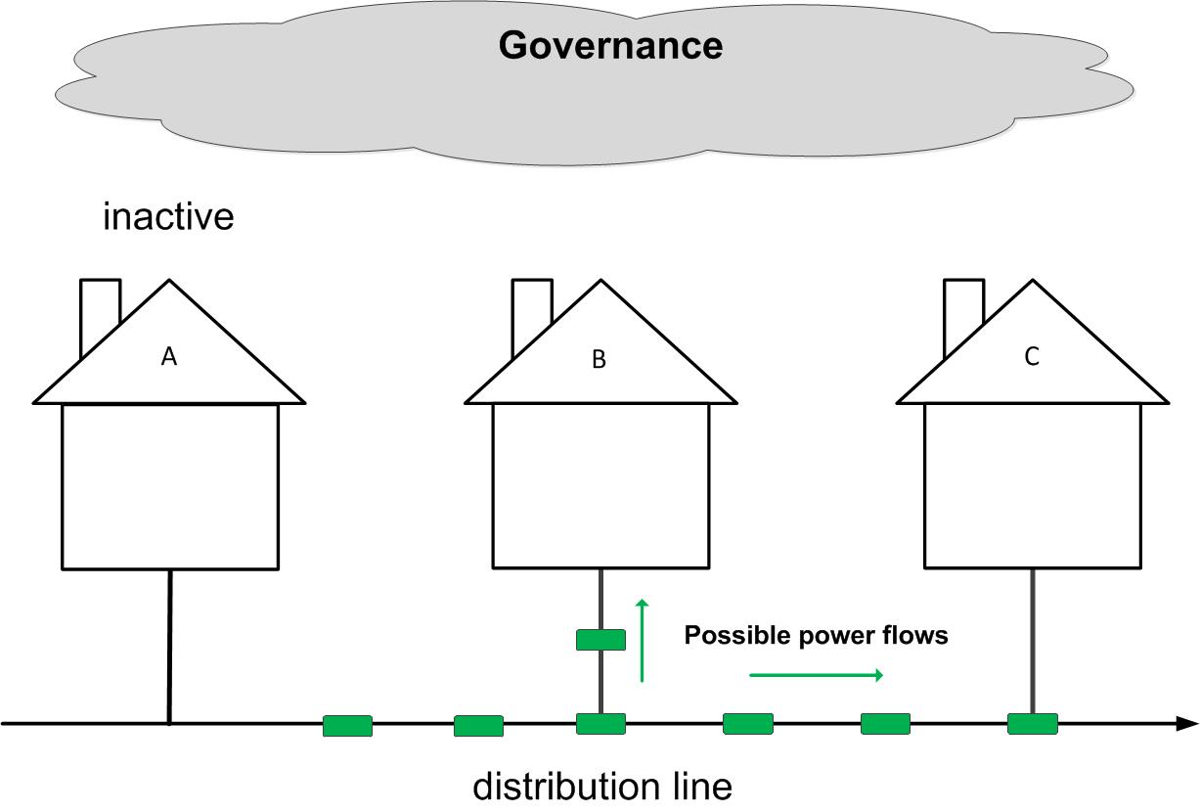
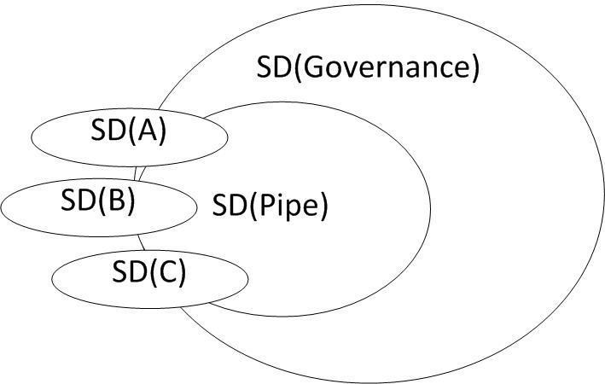
The overlapping security domains in an IoT smart grid environment.
Deducible
Non-Deducible
Non-Deducible

Slide 31
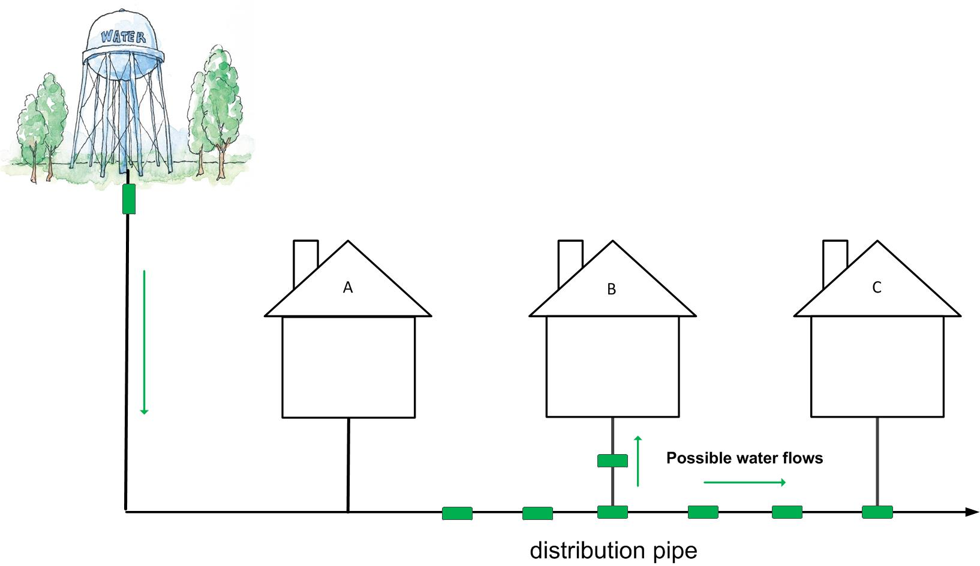


Information Present in the Physical Entity

Slide 32
Information Flow Models
A CPS performs physical actions that are observable
Should keep these secret – loss of confidentiality/privacy
Should not keep these secret – loss of integrity
Some models
Non-interference – Goguen and Messegeur 1982
High-level events do not interfere with the low level outputs
Non-inference – O’Halloran 1990
Removing high-level events leaves a valid system trace
Non-deducibility – Sutherland 1986
Low-level observation is compatible with any of the high-level inputs.

Slide 33
Information Present in the Physical Entity (Non-interference view)
Command Actions Blocked
Command
Not a good model for CPS

Slide 34
Information Flow Models
A CPS performs physical actions that are observable
Should keep these secret – loss of confidentiality/privacy
Should not keep these secret – loss of integrity
Some models
Non-interference – Goguen and Messegeur 1982
High-level events do not interfere with the low level outputs
Non-inference – O-Halloran 1990
Removing high-level events leaves a valid system trace
Non-deducibility – Sutherland 1986
Low-level observation is compatible with any of the high-level inputs.

Slide 35

Information Present in the Physical Entity (Non-inference view)
Potentially a good model for CPS
Command

Slide 36
Information Flow Models
A CPS performs physical actions that are observable
Should keep these secret – loss of confidentiality/privacy
Should not keep these secret – loss of integrity
Some models
Non-interference – Goguen and Messegeur 1982
High-level events do not interfere with the low level outputs
Non-inference – O-Halloran 1990
Removing high-level events leaves a valid system trace
Non-deducibility – Sutherland 1986
Low-level observation is compatible with any of the high-level inputs.

Slide 37
Information Present in the Physical Entity (Non-deducibility view)
A good model for CPS
Command

Slide 38
The overlapping security domains in a CPS environment.
Deducible
Non-Deducible
Non-Deducible

Slide 39

Non-deducibility
Non-deducibility
Good?
- Bad?
Secure Domain
Open Domain
Open Domain
Non-deducibility is a bidirectional model.
Inside Domain

Slide 40
The Challenge
Prevent the bad guys from seeing confidential/private information.
Make sure the good guys can deduce that an attack is happening from the bad guys
In a CPS
With the same model

Slide 41
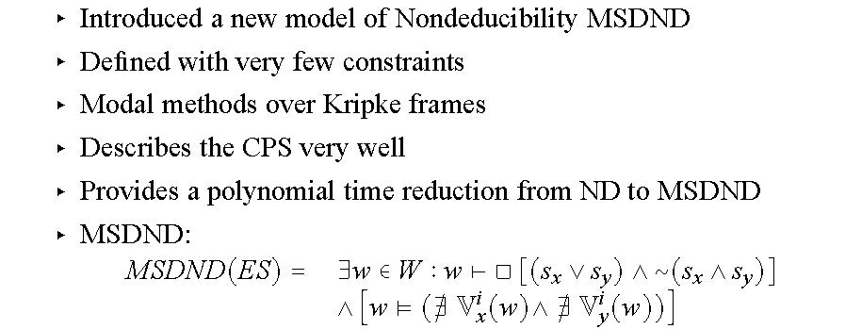
Multiple Domain Nondeducibility
On any given world, the valuation functions, V^{i}_{x} (w) , will return the value of the corresponding state variable x as seen by an entity in a partition, i.

Slide 42
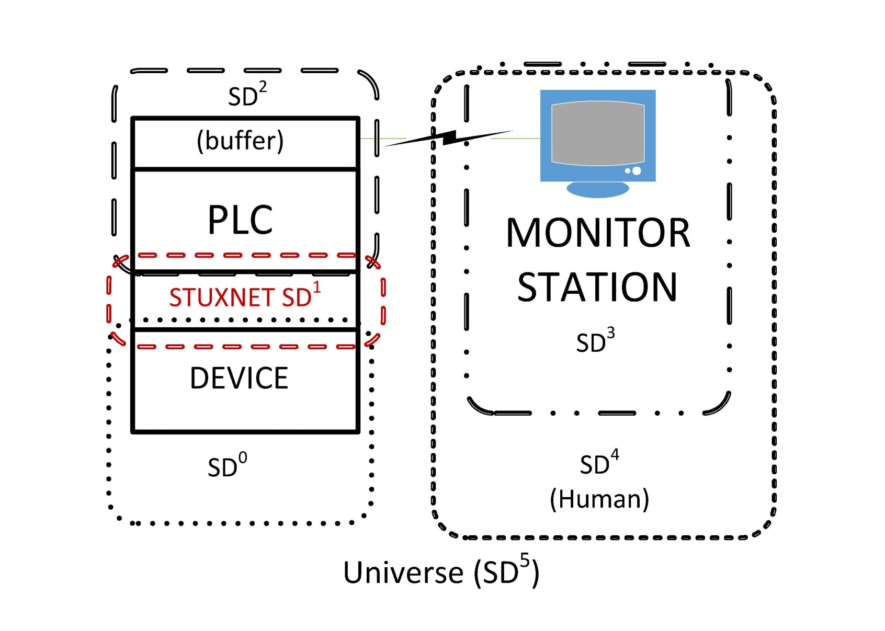
Multiple Domains of Stuxnet

Slide 43
Stuxnet Attack
I2,1, B2I2,1
T2,1
I1,0, B1I1,0
T1,0

Slide 44
Stuxnet Attack
I2,1, B2I2,1
T2,1
Alert,
Mismatch
I4,3, ~B4I4,3
~T4,3
I1,0, B1I1,0
T1,0
I4,0, B4I4,0
T4,0

Slide 45
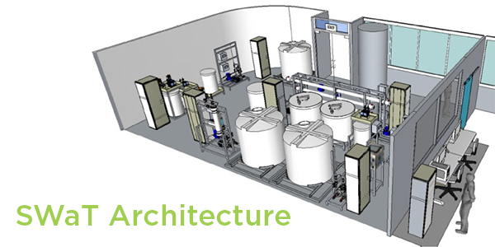
Secure Water Treatment Testbed (SWaT)
Filtration Units
Monitoring Station
Tank

Slide 46
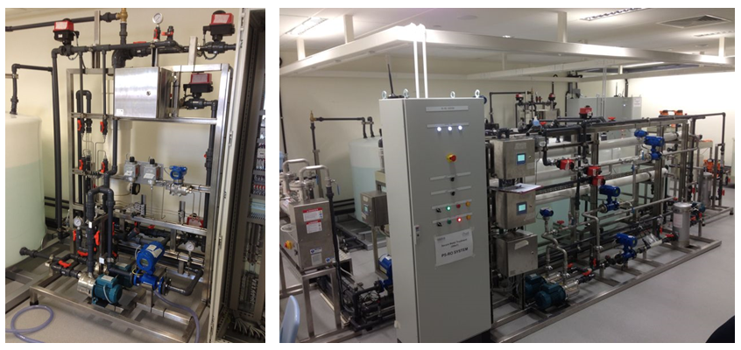
SWaT is currently located at SUTD University, Singapore.
It consists of 6 processes for water purification
It consists of 42 sensors and actuators
MSDND model is applied onto SWaT

Slide 47
Process 1: Raw Water
Purpose is to supply water to other processes of SWaT

Slide 48
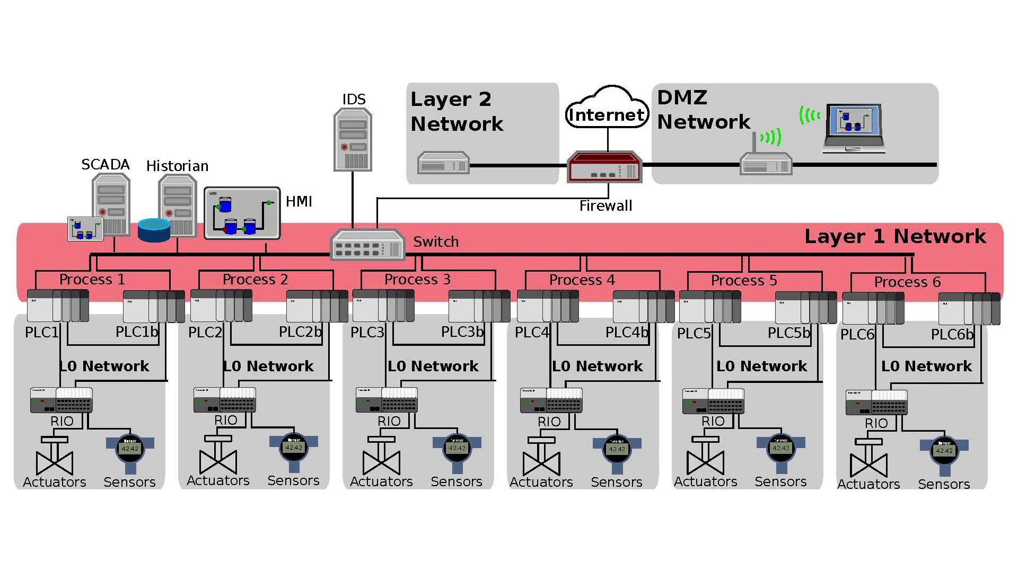
System Architecture
Level 0: Ring Network, Level 1: Star Network

Slide 49
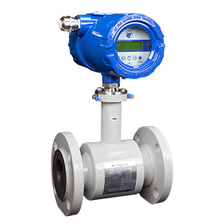
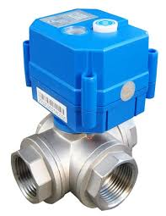
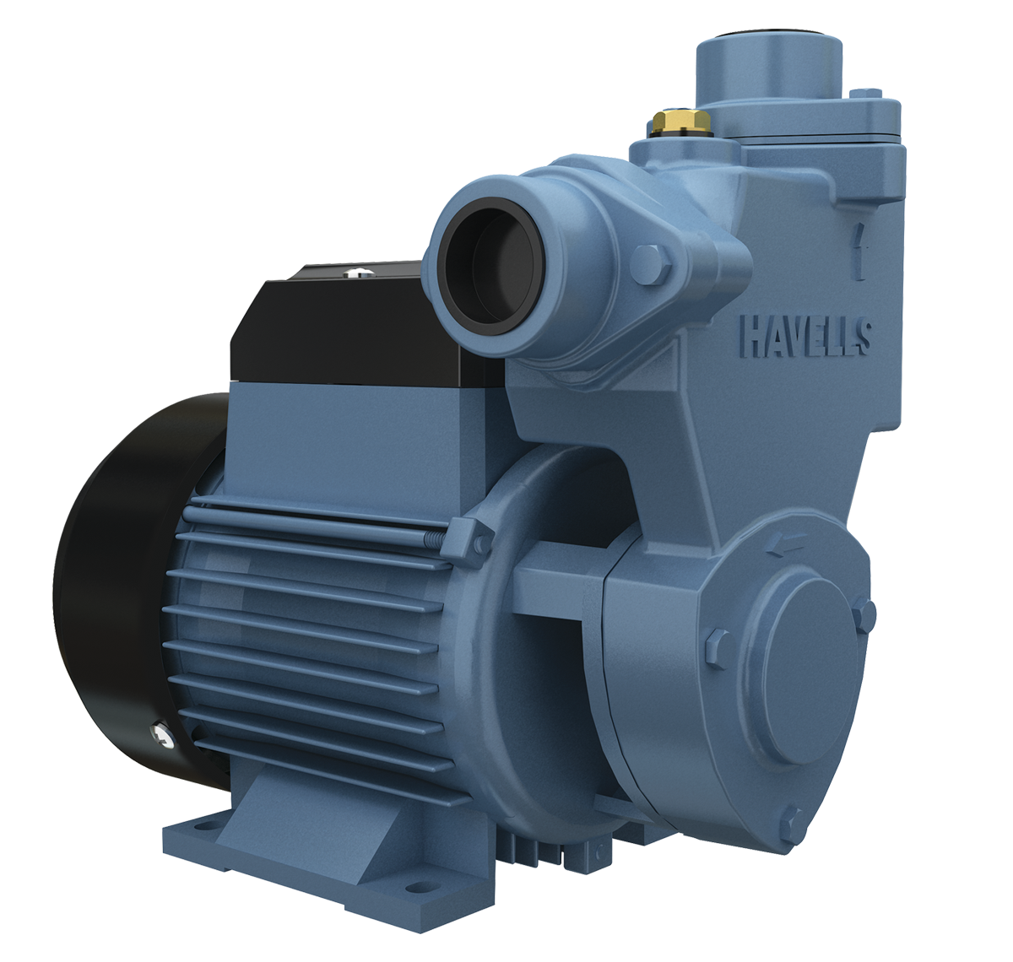
Working of MSDND
PROCESS 1
SD₅
PLC 1
FIT101
SD₀
MV101
SD₁
LIT101
SD₂
P101
SD₃
FIT101
SD₄
Flow Sensor
Valve
RAW WATER TANK
PUMP
Flow Sensor
LIT – Level Indication Transmitter, FIT – Flow Indication Transmitter, MV101 – Motorized Valves and P - Pump

Slide 50
Working of MSDND (Cont.)
PLC1
Operator
I_{5,6}l
B₅I₅,₆l
T_{5,6}l
SD5
VIRUS
SD6
SD0
I_{6,2} ∼l
B₆I_{6,2} ∼l
T_{6,2} ∼l
FIT101
LIT101
SD2
FIT102
SD4
SD1
Tank
T101
SD3
MV101
PUMP

Slide 51
Working of MSDND (Cont.)
Since B₅I₅,₆ l ∧ T_{5,6} l → B₅ l, the PLC believes the lie told in all cases. Therefore, unknown to entities in SD2, V₂l (w) and V₂∼l (w) cannot be evaluated. Therefore l is MSDND secure from SD2.
MSDND(ES) = ∃ w ∈ W →[(S_{l}⊕ S_{∼l} )] ∧ [w |= (∄V ^{SD5}_{∼l} (w) ∧ ∄V ^{SD5}_{l} (w))]
This is BAD for the plant as the threat goes undetected

Slide 52
Working of MSDND (Cont.)
Total Water = (Water Inflow – Water Outflow) * Const
I_{7,8}l
B₅I_{7,8}l
T_{7,8}l
PLC1
Operator
I_{5,6}l
B₅I₅,₆l
T_{5,6}l
SD5
SD8
SD6
VIRUS
SD0
I_{6,2} ∼l
B₃I_{6,2} ∼l
T_{6,2} ∼l
FIT101
LIT101
SD2
FIT102
SD4
SD1
Tank
T101
SD3
MV101
PUMP

Slide 53
Working of MSDND (Cont.)
Now when we take the ‘and’ operation for both the normal working and when an invariant is considered, we can conclude that the system is working normally
S_{invariant} ∧ S_{l} = S∗; System is working normally if and if only this is true
MSDND(ES) = ∃ w ∈ W →[(S∗ ⊕ S_{∼l} )] ∧ [w |= (∄V ^{SD5}_{∼l} (w) ∧ ∃V^{SD5}_{l} (w))]

Slide 54
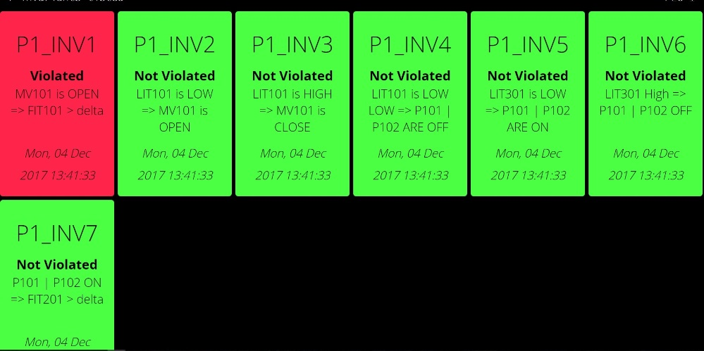
Working of MSDND (Cont.)
When an invariant fails, the tile with that invariant turns red

Slide 55
Process | Comp | Summary | Suggestions
Process 1 | 4 | Invariants Developed : 4 Invariants Matching : 4 Vulnerabilities remaining : 0 | Invariants for FIT and LIT should be modified to better capture multipoint attacks
Process 2 | 11 | Invariants Developed : 7 Invariants Matching : 0 Vulnerabilities remaining : 6 | Chemical processes should be further analyzed for getting more reliable invariants. Chemical dosing pumps and level indication should be modified.
Process 3 | 9 | Invariants Developed : 4 Invariants Matching : 3 Vulnerabilities remaining : 2 | Several attacks can be performed on motorized valves for damaging pumps and draining water. Install PIT near UF Unit to generate invariant for DPIT
Process 4 | 7 | Invariants Developed : 3 Invariants Matching : 3 Vulnerabilities remaining : 1 | Dichlorination Unit and NaHSO3 dosings effects chemical properties of water, using this, better invariants should be made as it effects RO Unit
Conclusion (Cont.)

Slide 56
Process | Comp | Summary | Suggestions
Process 5 | 16 | Invariants Developed : 7 Invariants Matching : 0 Vulnerabilities remaining : 9 | Many MSDND Secure paths are identified, invariants should be developed to break the MSDND security
Process 6 | 7 | Invariants Developed : 2 Invariants Matching : 0 Vulnerabilities remaining : 5 | Level switches should be replaced with level indicators, and more FIT’s should be installed for getting invariant

Slide 57
Another Typical Result
Power System Testbed in Singapore
Solar
Batteries
Generators
Loads

Slide 58
What to do with this information?

Slide 59
What to do with this information?
Measure System Security Resilience
Using the uniform information flow model
Improve Design
Mitigate MSDND paths
Mitigate Attacks through Engineered Knowledge to Break MSDND
Active defense against
Cyber Enabled Physical
Physically Enabled Cyber
This is Hard to Do

Slide 60
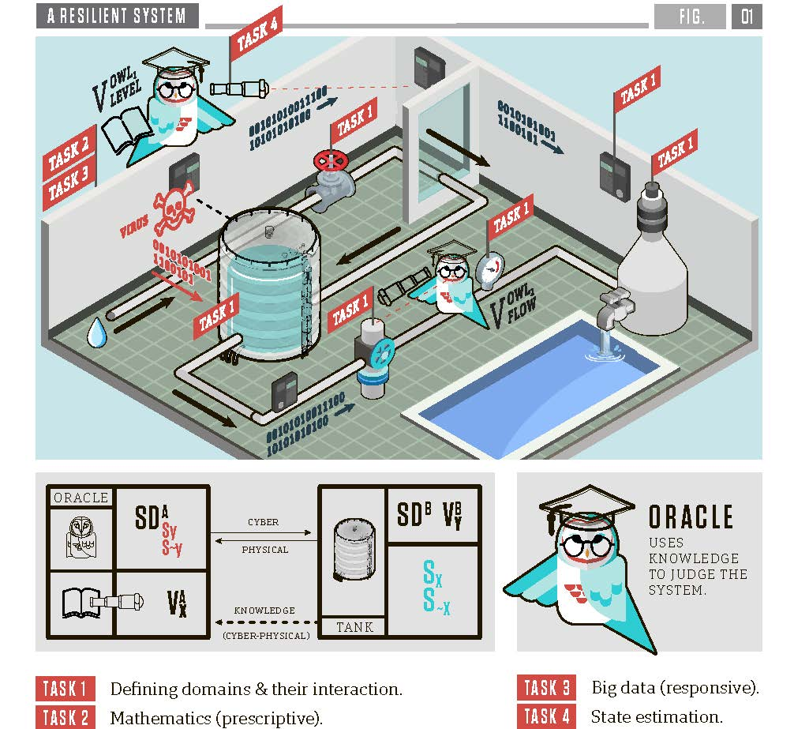
How to provide a functioning CPS without relying on assumptions of trust, but instead developing trust among components?
Goals
Automated Security Domain Construction
Semantic Bridges and Oracle Owls
Design-Centric
Port Hamiltonian Systems
State Estimation
Algebraic, Spatio-temporal & Real-Time Dynamic State Estimation
Data Science
Learn behavior with ground truth
Experimentation on real infrastructures
Power, Water, Manufacturing, Transportation
Notes:
A brief background: Please describe the problem you are addressing and why it is important (20sec slide)

Slide 61
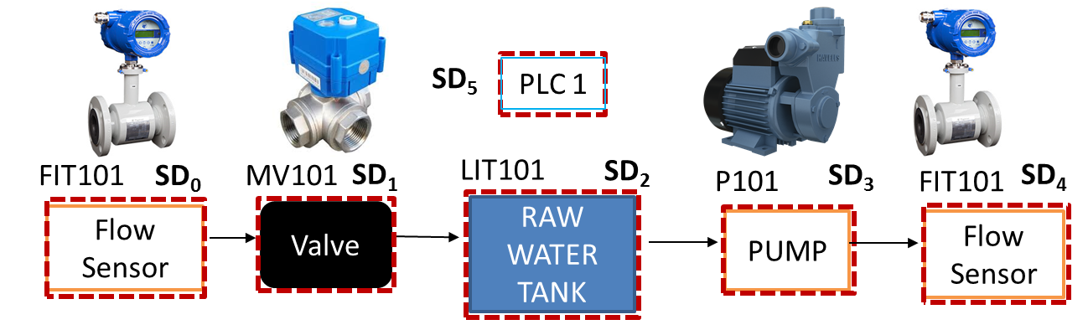
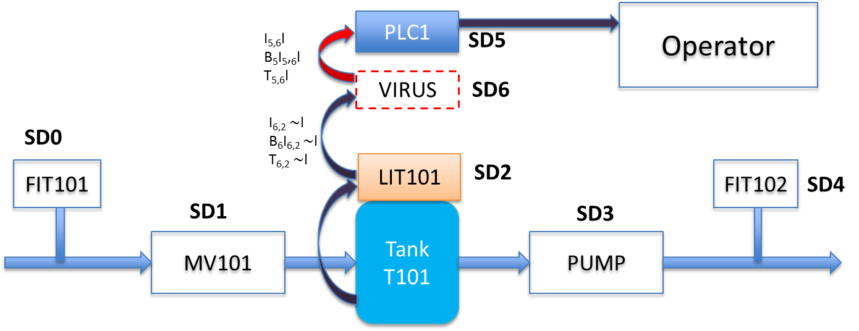
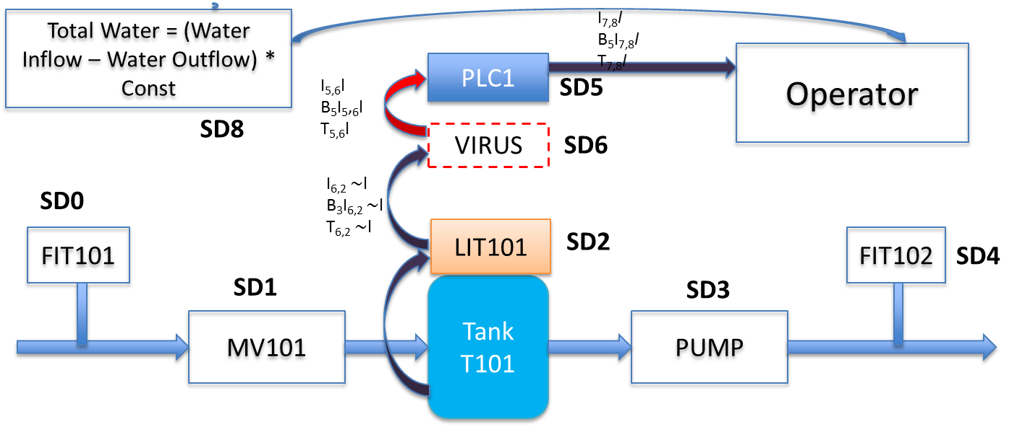
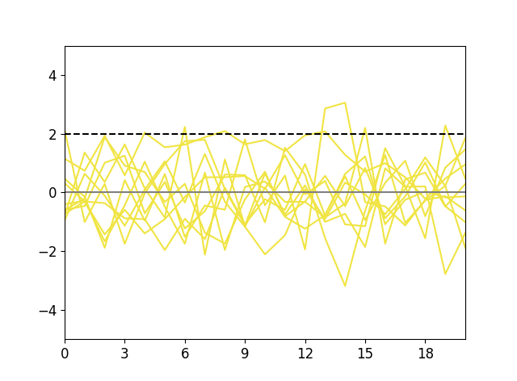
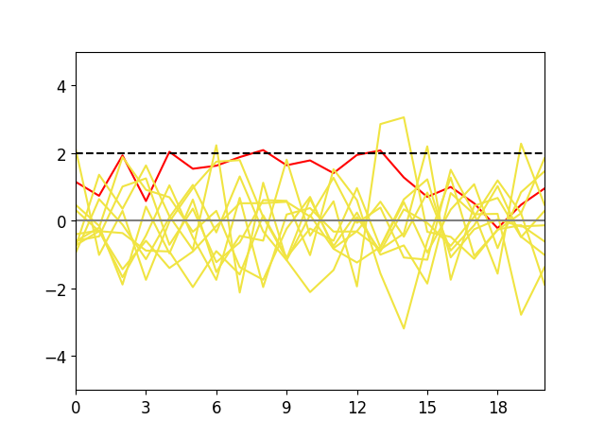
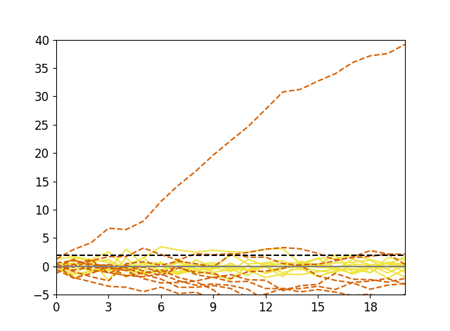
Findings
Data Centric
Diverge
Design Centric
Association Rule Mining, Generalized Linear Modeling
?
Subtle Theft, Slow Drift
Notes:
Please briefly describe prior research in your problem and the gaps in the existing science (30sec slide)

Slide 62
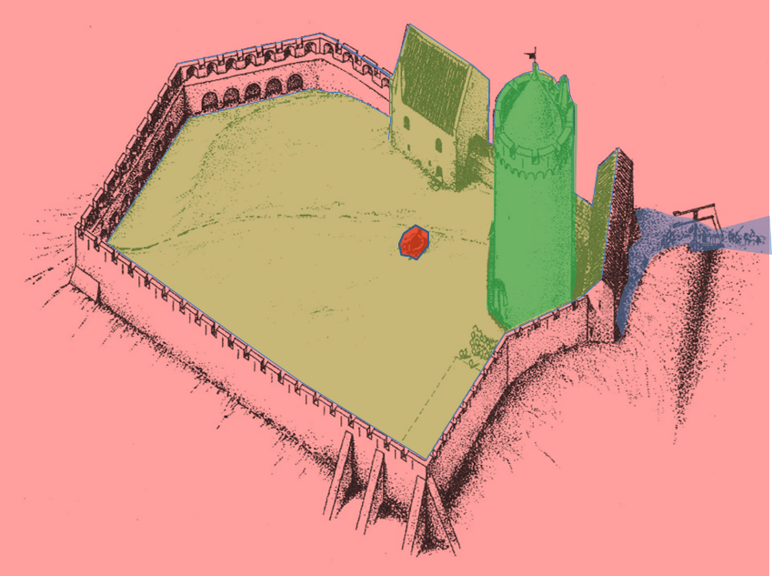

Modern Environment
Multiple security domains
High/low, Insider vs Outsider has changed
We are INSIDE the system
How do we secure the cyber-physical?
Traditional View – Castle/Maginot Line/BLP
High level vs low level
Firewalls, Defense in Depth
Does not address cyber-physical nor insider attacks

Slide 63
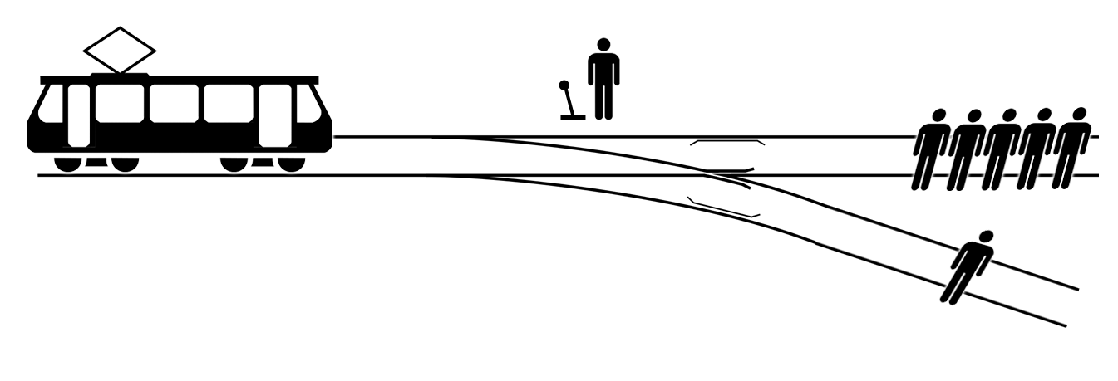
Ethics in these systems
Trolley Problem

Slide 64
Will people use this?
Privacy
Norway vs. USA
Resilience
Cyber threats
Fog?
Ethical Issues
Your Thoughts?

Slide 65

A Professional Society
Local Seminars
Get-together
Quality
Accreditation
Peer Review
Standards

Slide 66
Cyber-Physical Security Through Information Flow
Bruce McMillin
Professor, Department of Computer Science
2018-2020 Distinguished Visitor
Missouri University of Science and Technology
325 Computer Science, 500 W. 15th St., Rolla, MO 65409
o/ (573) 341-6435 e/ ff@mst.edu

